Slide 1
Visualization on suicide rates

Slide 2
Problem statement
Causes for the increase in suicide rates globally

Slide 3
Motivation
An extremely complex issue that causes pain to hundreds of thousands of people every year around the world is death by suicide.
Sixty percent of deaths from firearms result from suicide, which is particularly high in the U.S.
To prevent suicide and suicide attempts, evidence-based and effective interventions are implemented at the population, sub-population, and individual levels.
Through this project, I wanted to analyze this very anomaly and explore whether there is a relationship between the cause behind these suicides and the suicide rates in the country with the available data on this topic.

Slide 4
Approach
The dataset I have opted for this project is from Kaggle website.
dataset has information of suicide rates from the year 1985 to the year 2016.
Data cleaning is performed using python.
the countries which do not give enough information to present the suicide rates and other unwanted columns are removed.
A new column, continent was added against each country.

Slide 5
Approach
Exploratory data analysis:
we are considering 93 countries and 6 continents for our analysis.
the Europeans have highest overall of the “suicides_no and suicides/100k_pop” and the African continent has the least.
the country Russian Federation has the highest number of suicides over all the 93 countries and the Antigua and Barbuda country has the least.
Over the period of 30 years (1985-2015), the number of suicides for the years 1999-2003 have the highest suicide rate and through the late 1980s and the early 1990s, it is the lowest.
The dataset has information for 7M population that committed suicides from which 5M are men and 2M are women, approximately.

Slide 6
Approach
Hypothesis:
if the population is higher then the number of suicides are higher and if the GDP (“gdp_per_capita”) is higher then the number of suicides are lower.
the rate of suicide is highest in men through age.
the older generation has the highest suicide rate and newer generation has the lowest.

Slide 7
Results
First Hypothesis:
it can be observed from the visualization “population by country and sex” that the United States, followed by Brazil, Russian Federation have the highest population and Aruba Kiribati has the least population.
The visualization “suicides_no by country and sex” gives us the information that the countries, Russian Federation, United States, followed by Japan has the highest number of suicides and the countries Antigua and Barbuda, followed by the Maldives has the least number of suicides.
the visualization report supports our assumptions: if the country has the highest population then the suicide rates are high.
considering the top few countries with high GDP has less population and the least number of suicides.
the number of suicides is positively correlated with population and both are negatively correlated with GDP.

Slide 8
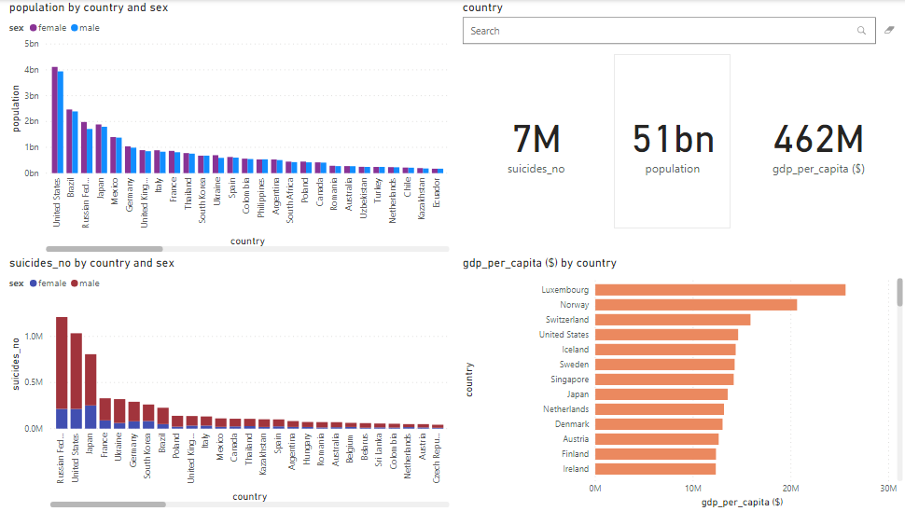
results

Slide 9
Results
second Hypothesis:
it can be observed from the visualization that the age groups 35-54 years, followed by 55-74 years and 25-34 years has the highest number of suicides.
when considering the country's population and age groups, men have the highest suicide rate.
the male population has the highest suicide rate.
Thus, in the total scenario of the report the male population through age has the highest suicide rate.

Slide 10
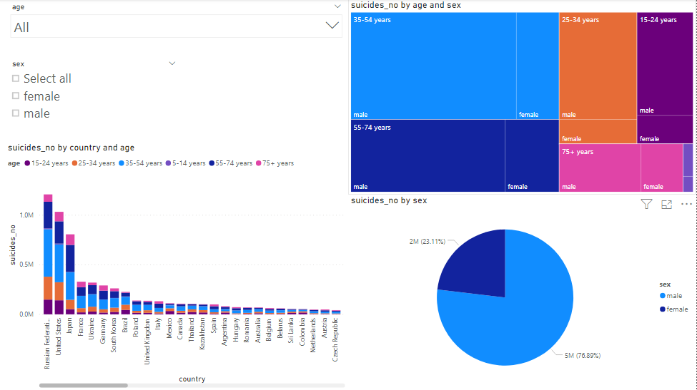
results

Slide 11
Results
third Hypothesis:
it can be observed from the visualization that in any continent the generation, Boomers, Generation X, Silent has the highest population.
it can be observed that the number of suicides is highest in Boomers, followed by Silent, Generation X, Millennials, G.I. Generation, and Generation Z.
For the final report on this visualization, it can be shown that though G.I. Generation is the oldest among all generations, it does not have the highest number of suicides which contradicts our hypothesis.

Slide 12
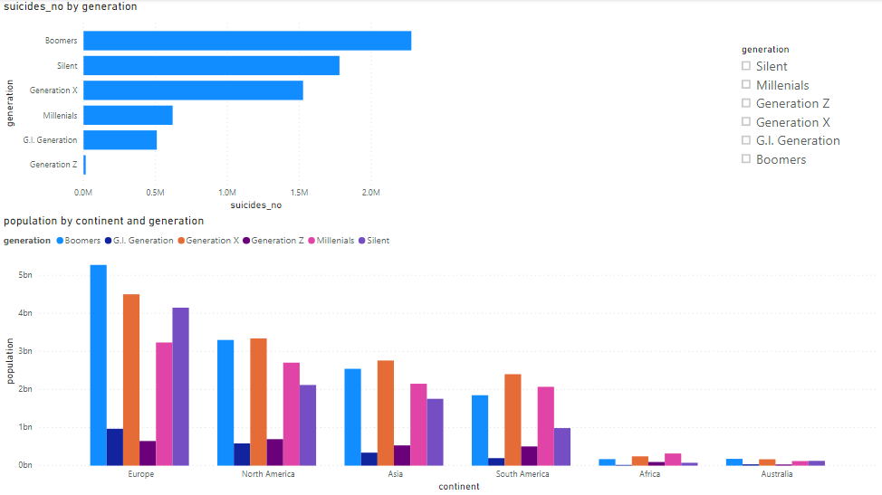

Slide 13
Future work
In this study, we focused on the causes of the increase in suicide rates and the source behind these suicides.
There is no research on other factors such as the measures against committing suicides such as the factors that influence the mental health of the individuals.
To date, the prevention factors have not been studied extensively or rigorously as the risk factors.
Hopefully, identifying and understanding, prevention factors will be equally as important as researching the risk factors for suicide.

Slide 14



Thank you

